Slide 1
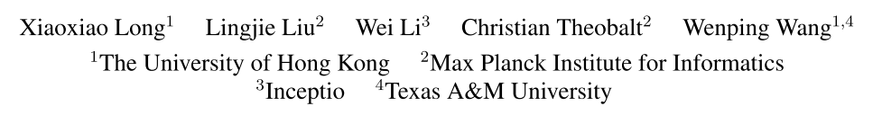
Multi-view Depth Estimation
using Epipolar Spatio-Temporal Networks
CVPR 2021

Slide 2
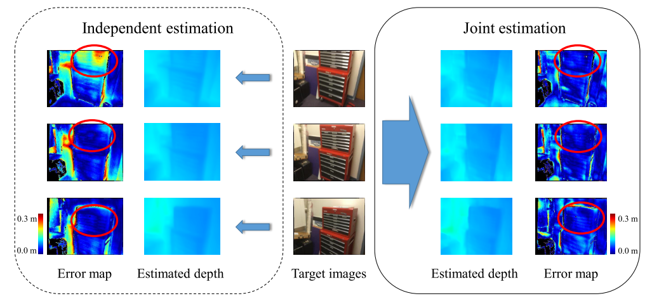
Motivation
SOTA models mostly adopt a fully 3D convolution network for cost regularization and therefore require high computational cost.
Most works estimate depth maps of individual video frames independently, without taking into consideration the strong relationship between frames.

Slide 3
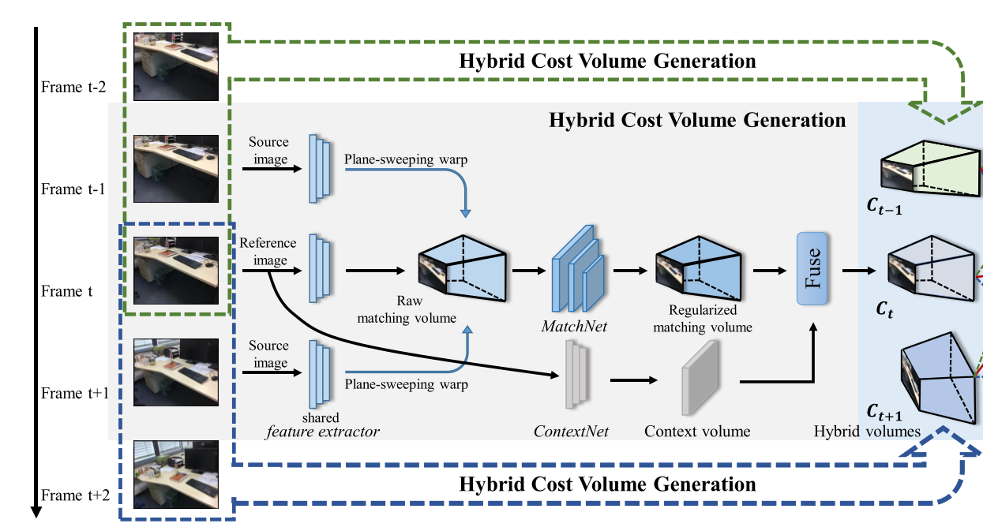
Method: Hybrid Network
How to fuse?
Treat context volume as 1 channel in regularized matching volume. (Concatenate)
(global information) (local feature)
Notes:
spatial pyramid pooling for feature extract

Slide 4
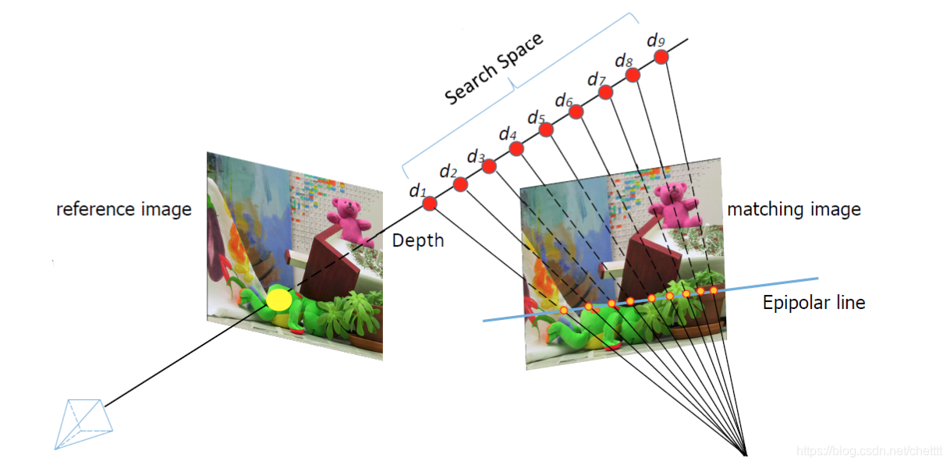
Method: EST Transformer
Photometric Consistency Assumption
A 3D point in world space will be projected into visible images, and the image textures near their projections should bear high similarity.
Epipolar Search

Slide 5
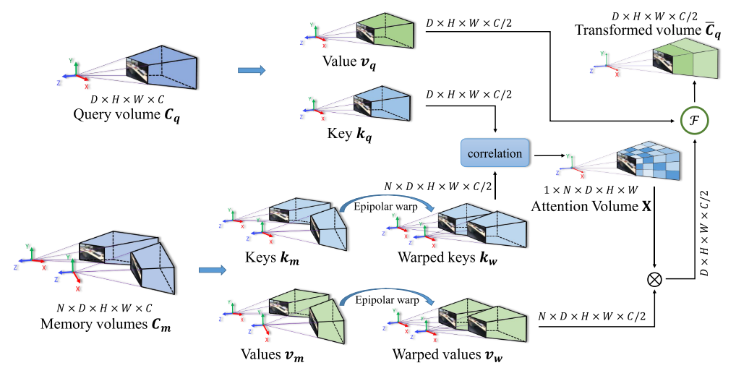

Method: EST Transformer
How to fuse?
w、r是可学习的权重；g表示卷积操作

Slide 6
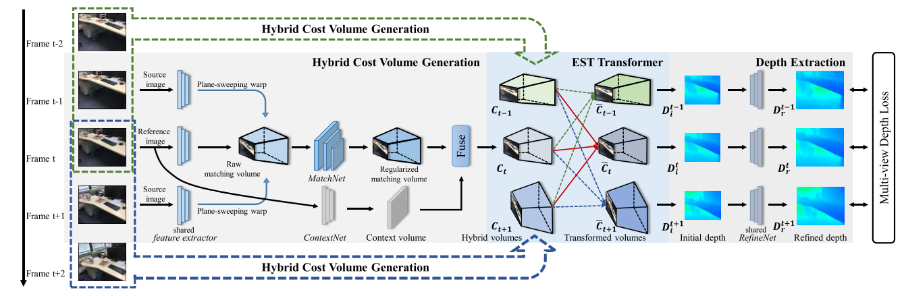
Method: Pipeline
Takes a short video sequence with 5 frames as input and jointly estimate the depth maps of 3 target images with short-term temporal coherence.

Slide 7
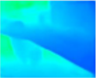

Method: Pipeline

Slide 8
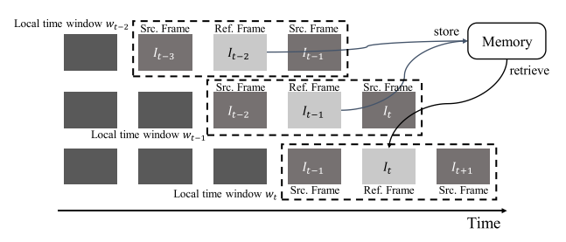
Method: Inference acceleration
Retrieve relevant values from a memory space storing the pairs of keys and values of N past frames.
Slide Window, when window moves on, the memory space will be also updated accordingly.

Slide 9
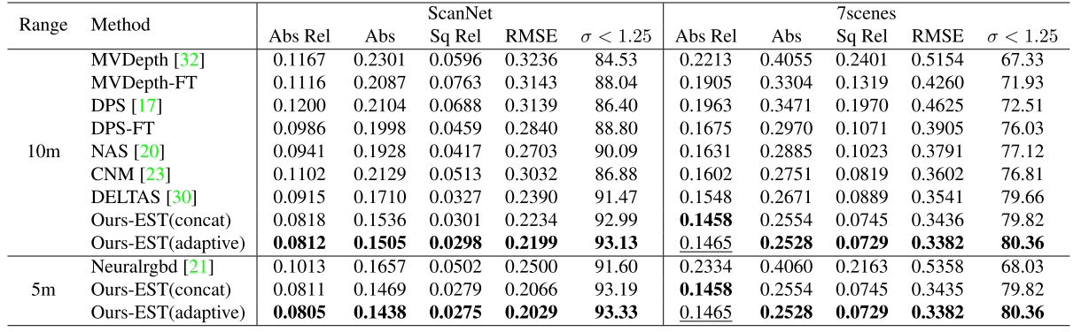
Experiment: Depth accurary
Notes:
less noise even in the texture-less regions

Slide 10
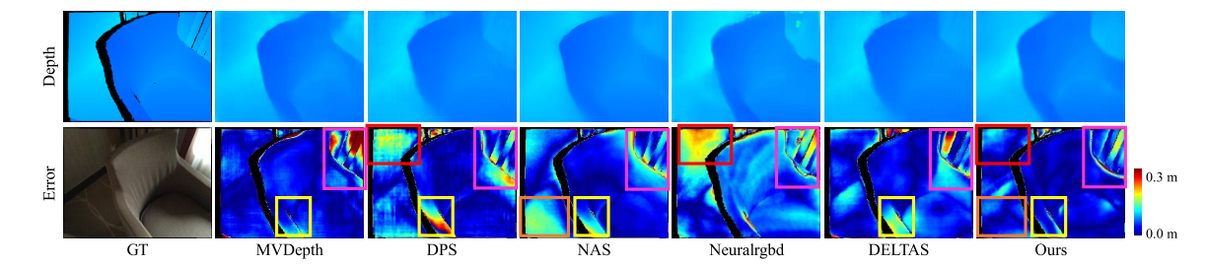
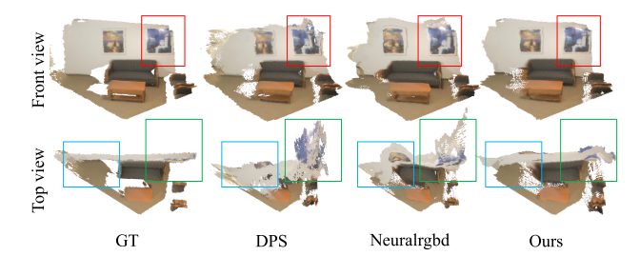
Experiment: Depth accurary
Notes:
less noise even in the texture-less regions

Slide 11
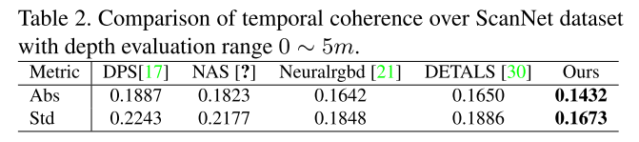
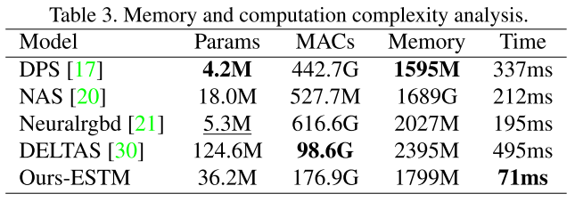
Experiment: Temporal coherence & complexity analysis

Slide 12
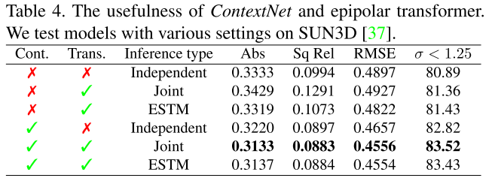
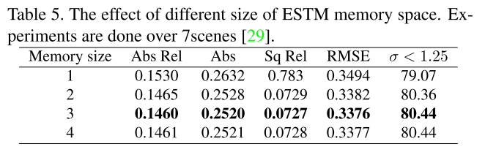
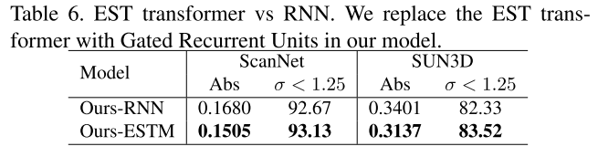
Experiment: Ablation study
Independent: without EST transfomer
Joint: with EST transfomer
ESTM: estimate depth sequentially

